Slide 1

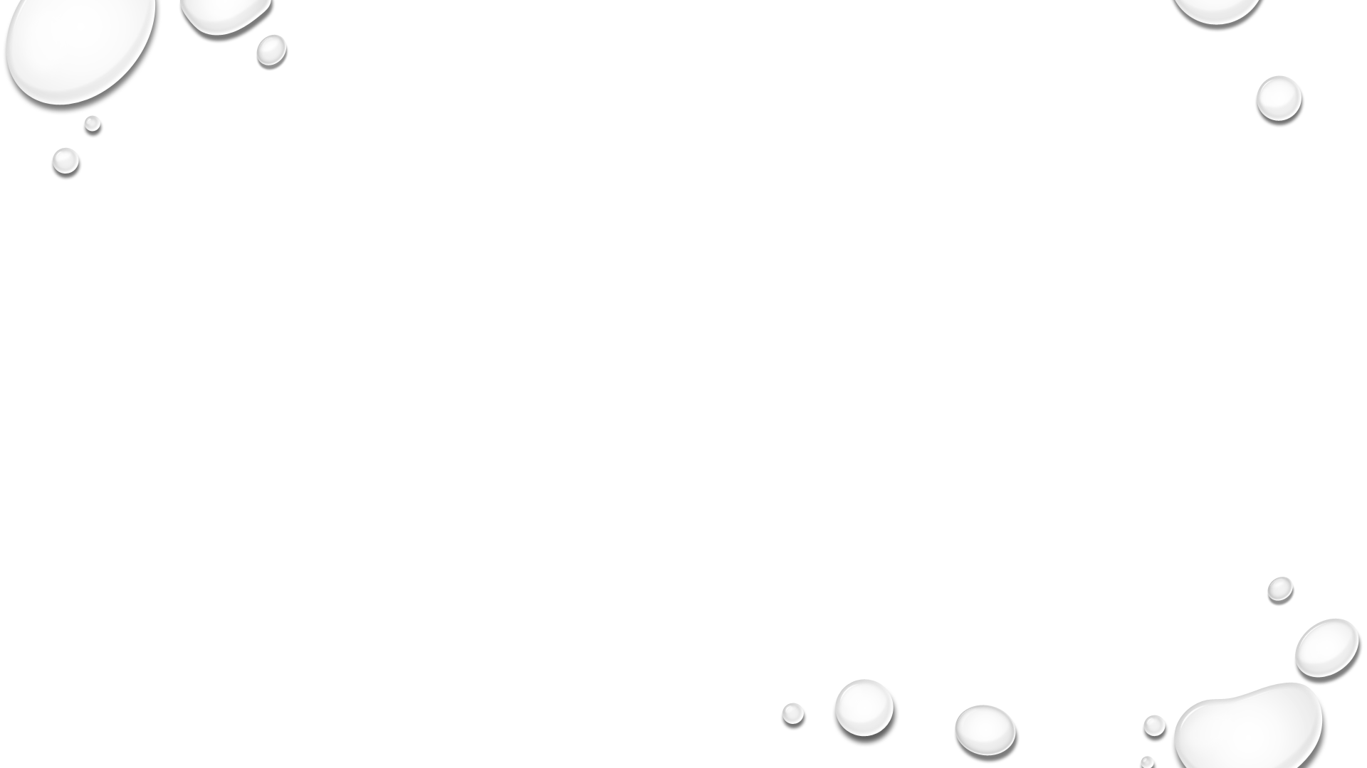


Slide 2
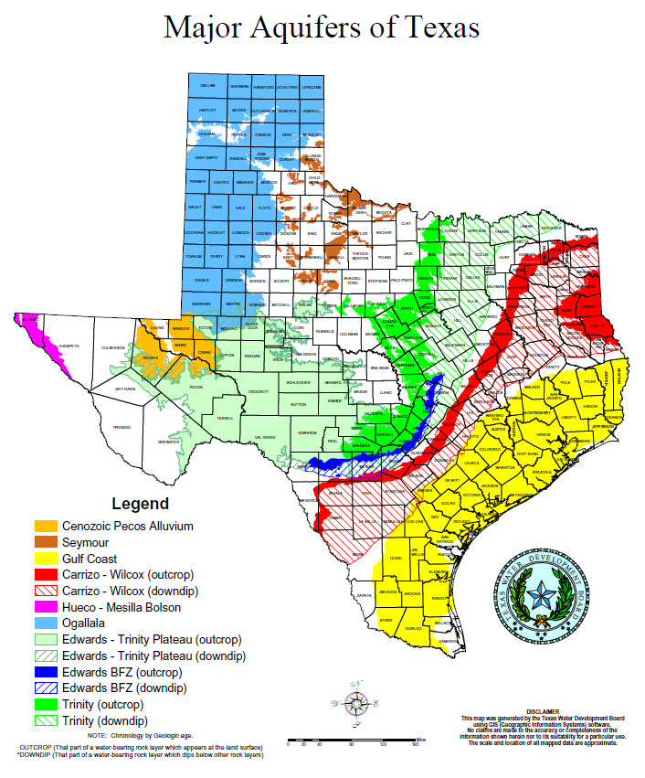
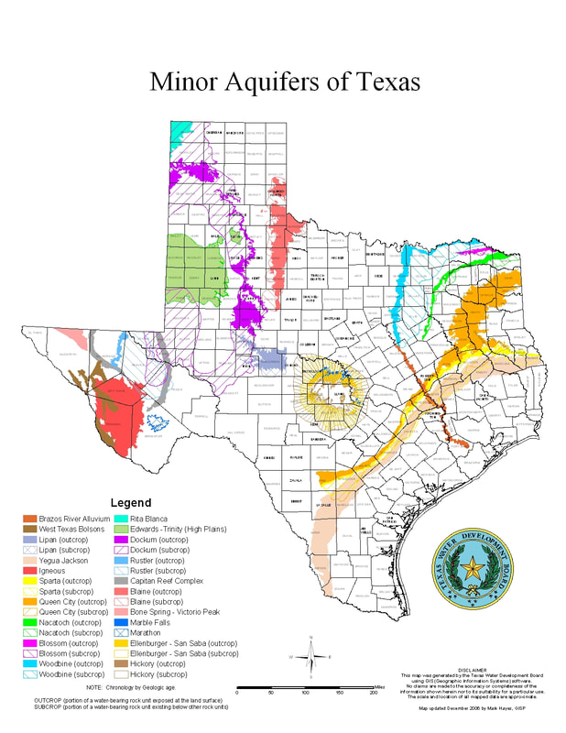
Aquifers that produce large amounts of water over large areas
Aquifers that produce minor amounts of water over large areas or large amounts of water over small areas

Slide 3
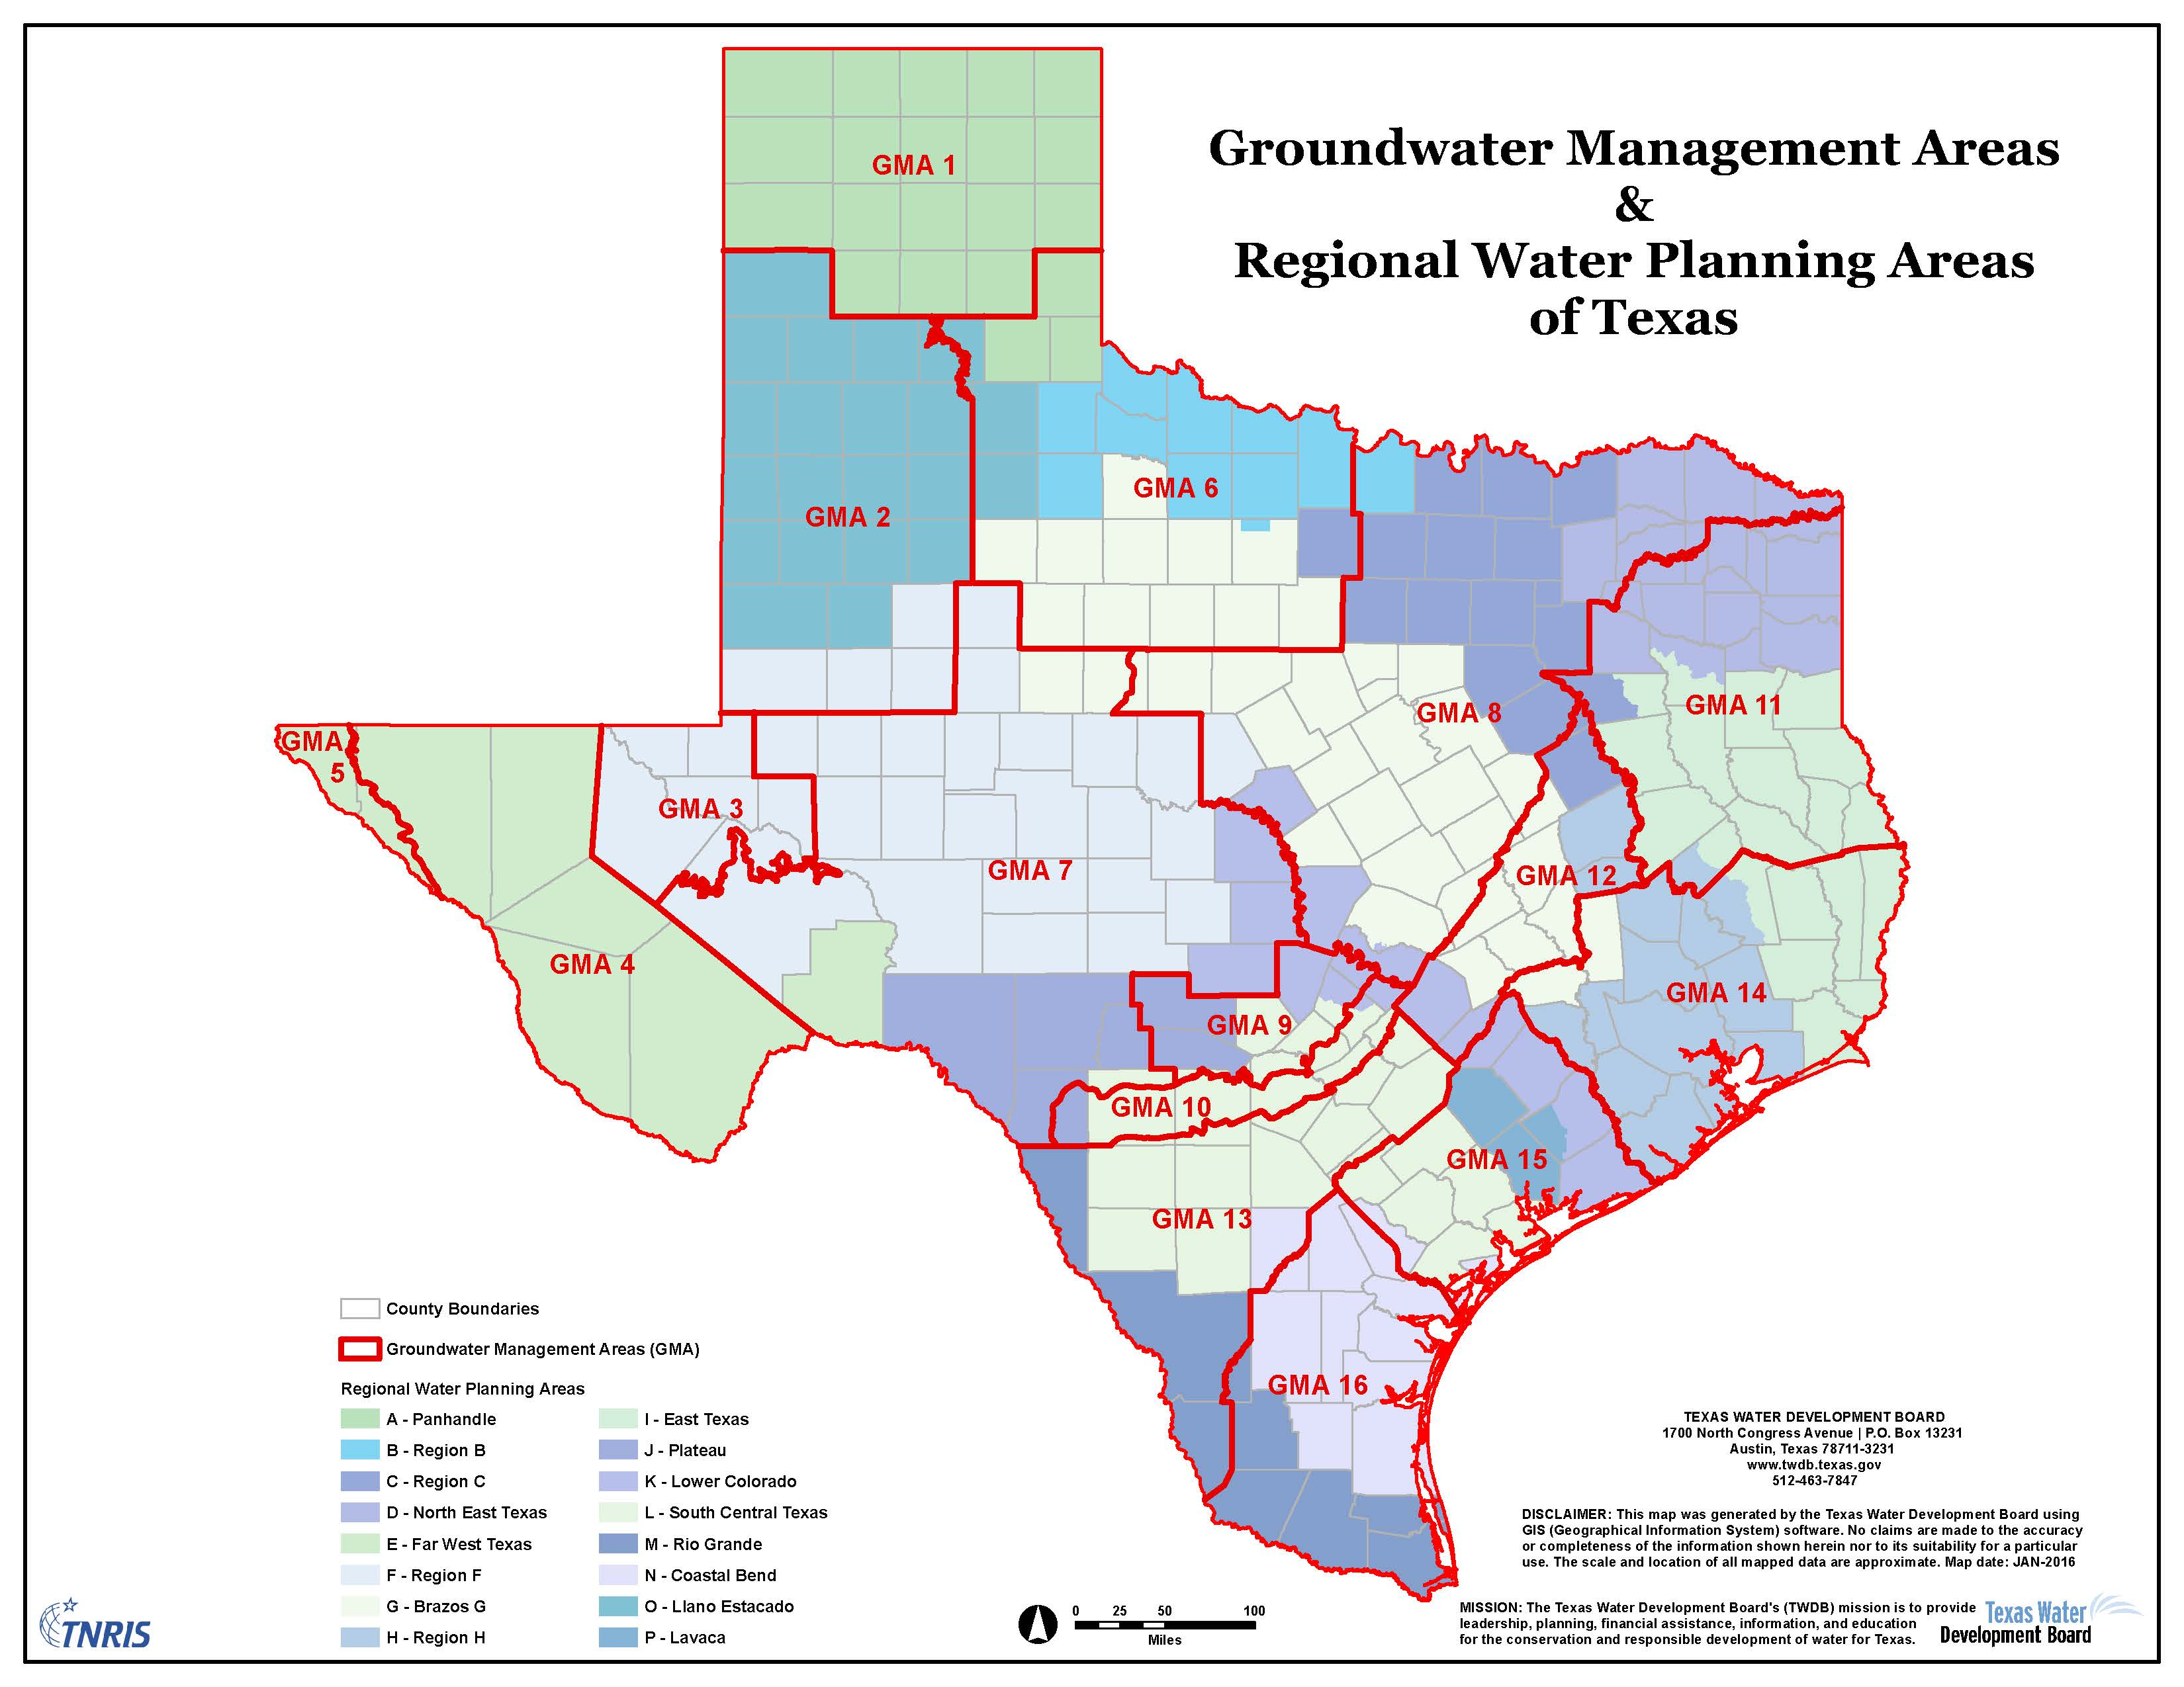
There are 16 Groundwater Management Areas in Texas.
All GCDs are a part of at least one Groundwater Management Area.

Slide 4
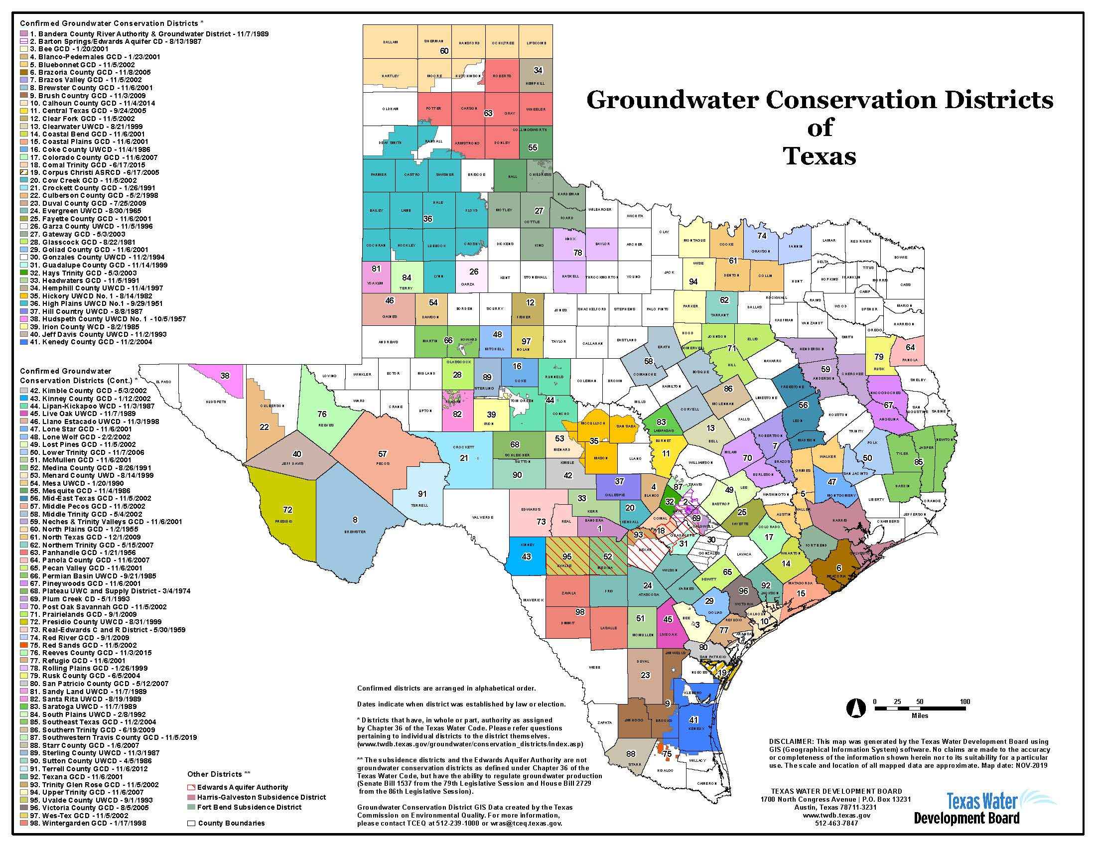
Districts report to:
  Texas Water Development Board
  Texas Commission on Environmental Quality
  Texas Department of Licensing and Regulation
Districts are formed based on characteristics of the aquifer, population, and specific uses of water as defined by the TWC Chapter 36 since 1963.
Each District develops a Groundwater Management Plan every five years in consideration of the actual use and type of use.

Slide 5

Groundwater Conservation District
Facts
There are 98 groundwater conservation districts (GCDs) in Texas.
A GCD or underground water conservation district (UWCD) is a district created under THE Texas Constitution, Article III, Section 52 or Article XVI, Section 59 that has the authority to regulate the spacing of water wells, the production from water wells, or both.
GCDs are created either by the Texas Legislature subject to the authority, conditions, and restrictions of Article XVI, Section 59 of the Texas Constitution, or by the Texas Commission on Environmental Quality through a local petition process (Texas Water Code §36.013 - §36.015).
Sixty-six groundwater conservation districts elect a board of directors, and thirty-one appoint a board of directors through the county commissioners’ courts, municipalities, or other entities.
High Plains Underground Water Conservation District (UWCD) No. 1, created in 1951, was the first GCD in Texas.
The smallest GCD, Red Sands GCD, covers an area of about 114 square miles. The largest GCD, High Plains UWCD No. 1, covers an area of about 11,940 square miles.
Confirmed GCDs (excluding the two subsidence districts and the Edwards Aquifer Authority) are located partially or fully within 173 of 254 Texas counties.
GCDs cover nearly 70 percent of the area of the state.
There are 60 single-county GCDs in Texas and 38 that cover more than one county.
While 95 of the 98 confirmed GCDs overlie a major aquifer, only 65 of these districts overlie a minor aquifer.
Approximately 72 percent of major and minor aquifers are overlain by a GCD.

Slide 6
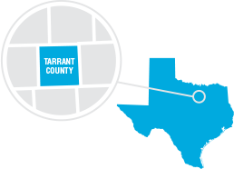
Overview of the Northern Trinity GCD
Tarrant County
Created by the 80th Texas Legislature in 2007 as a fee-based GCD vs tax-based
GCDs have the authority to regulate spacing and production of wells
GCDs are the preferred method of groundwater management in the state of Texas, and their authorities are outlined in Ch. 36 of the Texas Water Code
JOHNSON
SOMERVELL

Slide 7
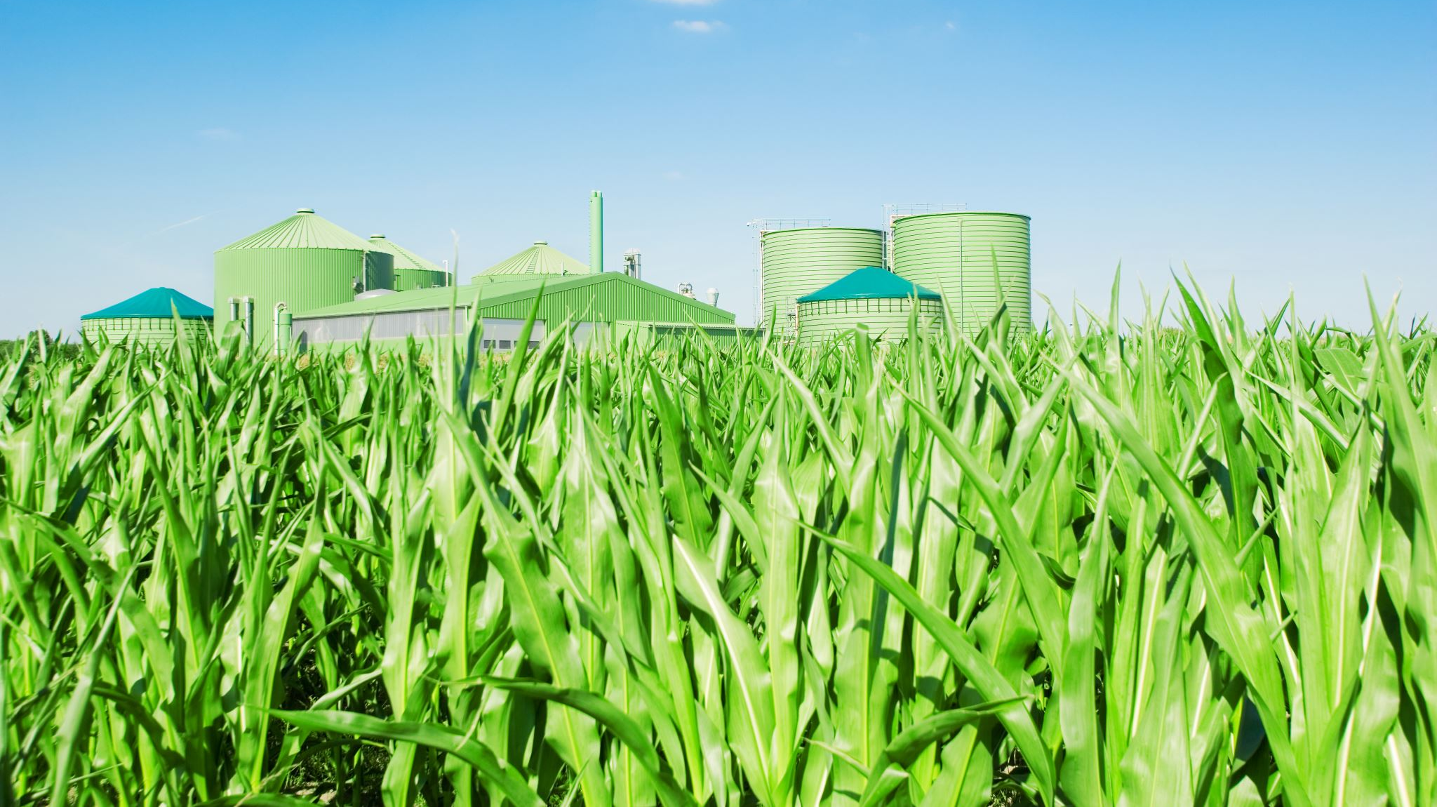
Registration of Water Wells
Status of water wells is determined by size and purpose:
  Non-Exempt wells
  - All public water supply wells
  - Wells that produce more than 17.36 gpm
  (36.117- incapable of producing more than 25,000 gpd)
  - Exception: domestic or agricultural use
  Exempt wells
  - All agriculture and domestic use
  - Wells that produce less than 17.36 gpm
  (36.117- incapable of producing more than 25,000 gpd)
  - Exception: Public water supply wells

Slide 8
Aquifers of NTGCD
- Paluxy
- Twin Mountains- Hensell
- Twin Mountains- Pearsall
- Twin Mountains- Hosston

Slide 9
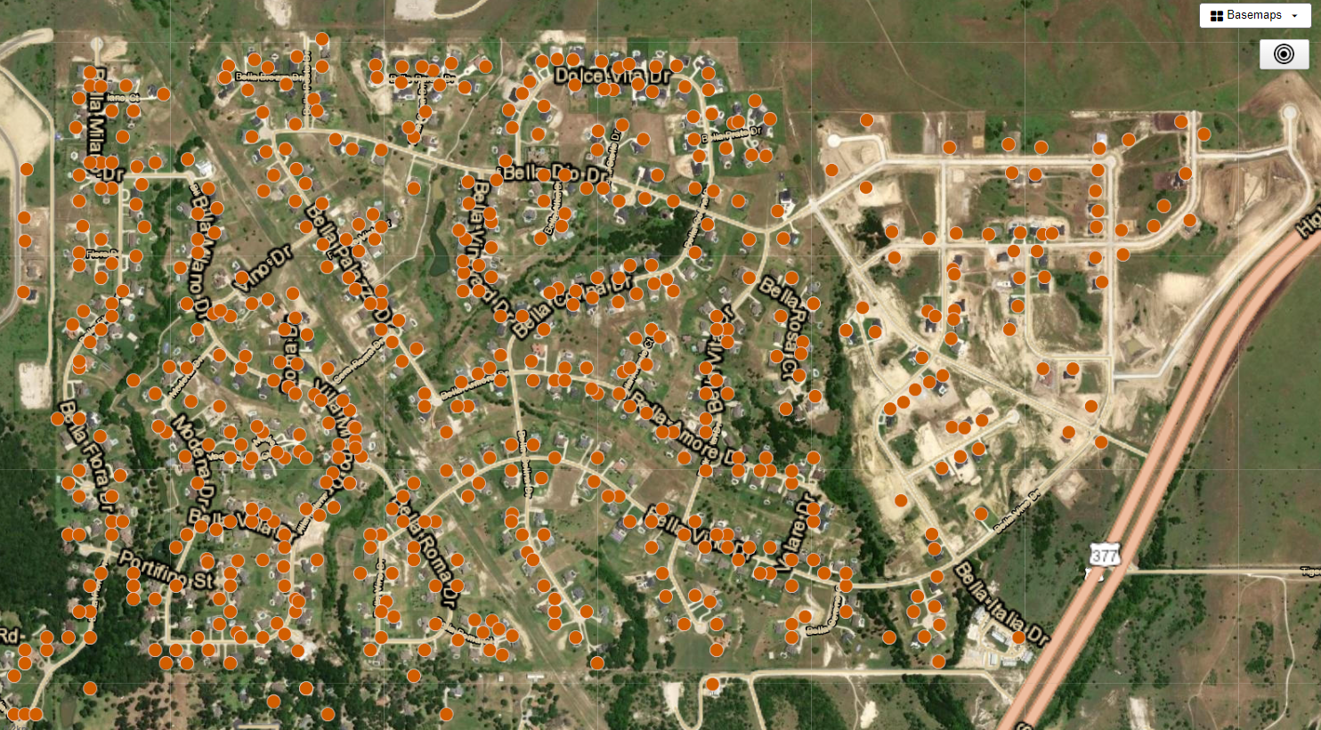
Well Density

Slide 10
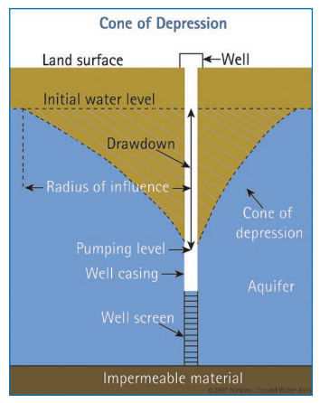
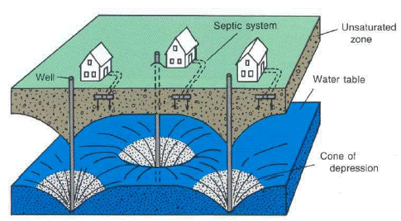
Courtesy of USGS

Slide 11
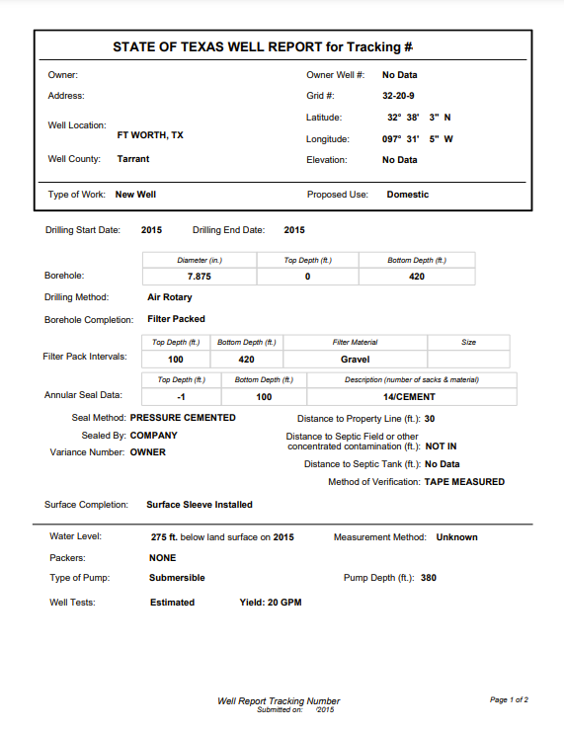
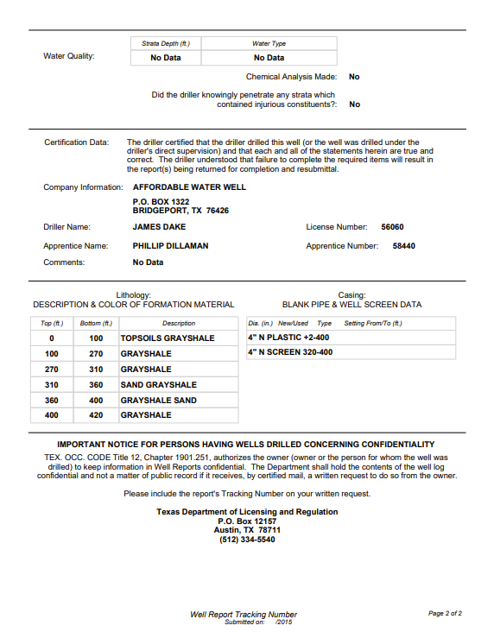
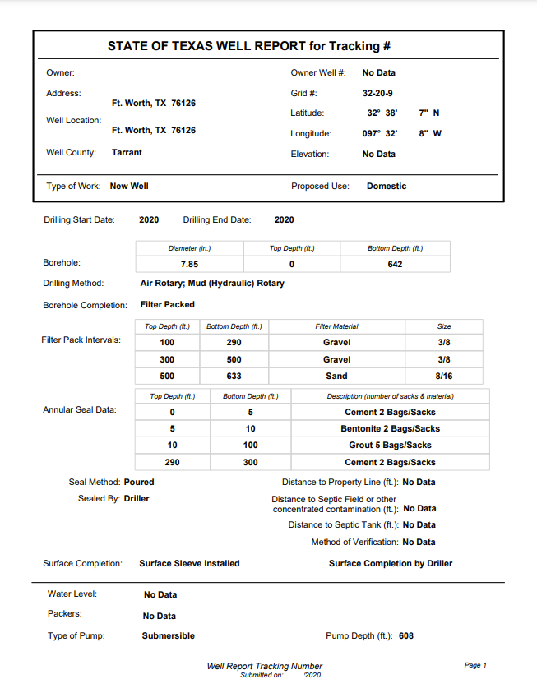
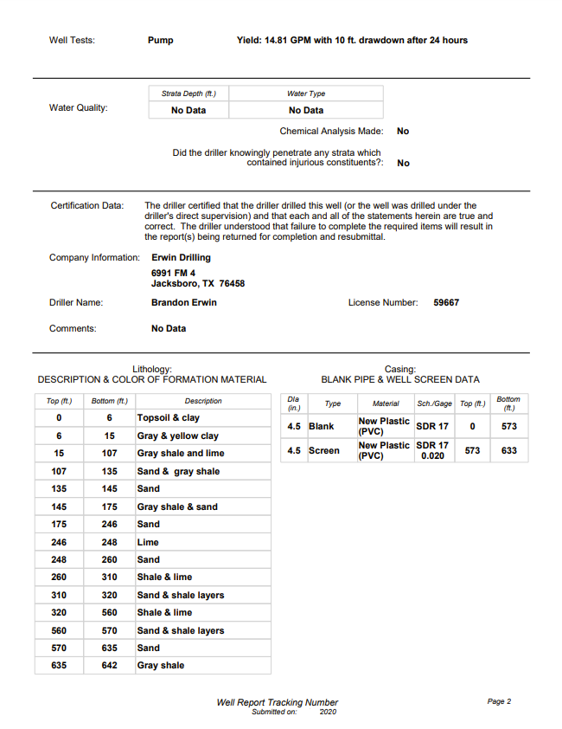
WELL LOG INFORMATION
Paluxy Well
+/- 400ft
Twin Mountains Well
+/- 700ft

Slide 12
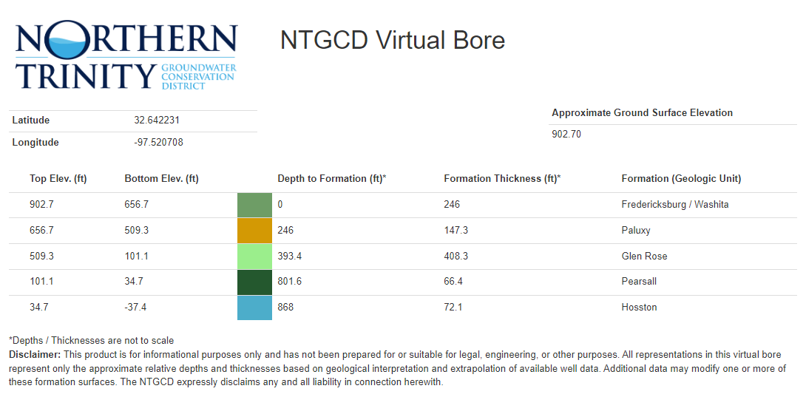

Slide 13
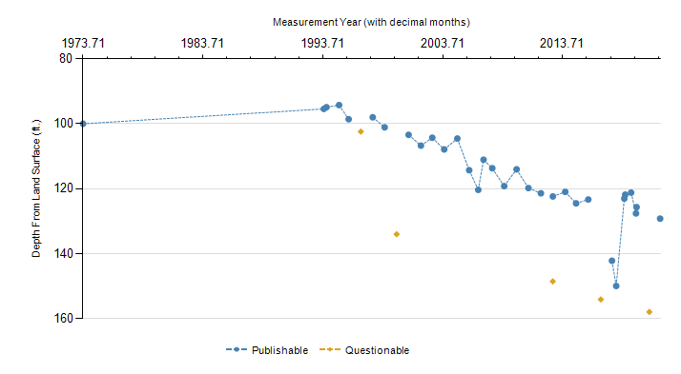
Closest Monitor Well
(377 and 1187)

Slide 14
Water Conservation outdoors
Planning and design
Soil analysis
Practical turf areas
Appropriate plant selection Efficient irrigation
Use of mulches
Appropriate maintenance
Soil Analysis: adding organic matter to the soil increases soil fertility and helps conserve water. Organic matter increases the soil's ability to absorb and store water.
Grass Selection: Various Grass types available for lawns in Texas have significantly different water needs. Using low water use turfgrass that is adapted to this region can significantly reduce irrigation requirements.
Plant Selection: Select ground cover, trees, and shrubs based on their adaptability to our soil and climate. eliminate weak, unadapted plants.
Watering Lawns: applying water infrequently yet thoroughly is the best way to create a deep, well-rooted lawn. Deeper roots help the lawn efficiently use water stored in the soil, especially during dry periods.
Irrigation: Proper maintenance of irrigation systems is key to achieving efficiency. Make sure heads are properly adjusted to avoid watering streets, driveways, FENCES, and walls. Spray heads must also be adjusted to mitigate wind drift. Upgrading to smart controllers is a great way to avoid unneeded watering. Don’t forget to adjust the watering schedule seasonally (4 times a year).
Mulch: Use mulch wherever possible. A good mulch conserves water by significantly reducing moisture evaporation from the soil.
Rainwater Harvesting: capturing rainwater is a great way to conserve water for irrigation purposes. This captured water is preferred by plants due to the lack of salts and other minerals.

Slide 15
Water Conservation Around the House
Leaks- pipes, toilets, and faucets should be checked regularly to ensure they are functioning properly
Fixtures- Install Efficient toilets, faucets, and showers to reduce water use throughout your home
Appliances- Using High efficiency appliances like dishwashers, washing machines, and water softeners can significantly reduce water use
Installing swimming pool covers to reduce evaporation

Slide 16
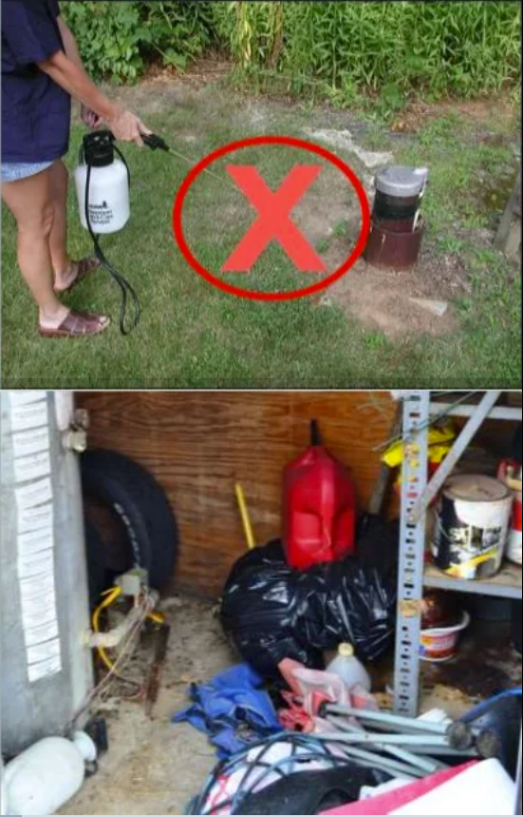
Conservation- Contamination
Water well systems should be periodically inspected to ensure they are in good repair. Deteriorated or improperly constructed wells can be contamination hazards for the aquifer.
Keep the area around the well free of any potential contamination sources. The well location should not be subject to flooding or drainage.
Reduce Chemical Use- Use fewer chemicals around your home and yard, and make sure to dispose of them properly. Don not use or store fertilizers, pesticides, oil, or paint around your well.
Manage Waste- Properly dispose of potentially toxic substances like unused chemicals, pharmaceuticals, paint, motor oil, and other substances.

Slide 17
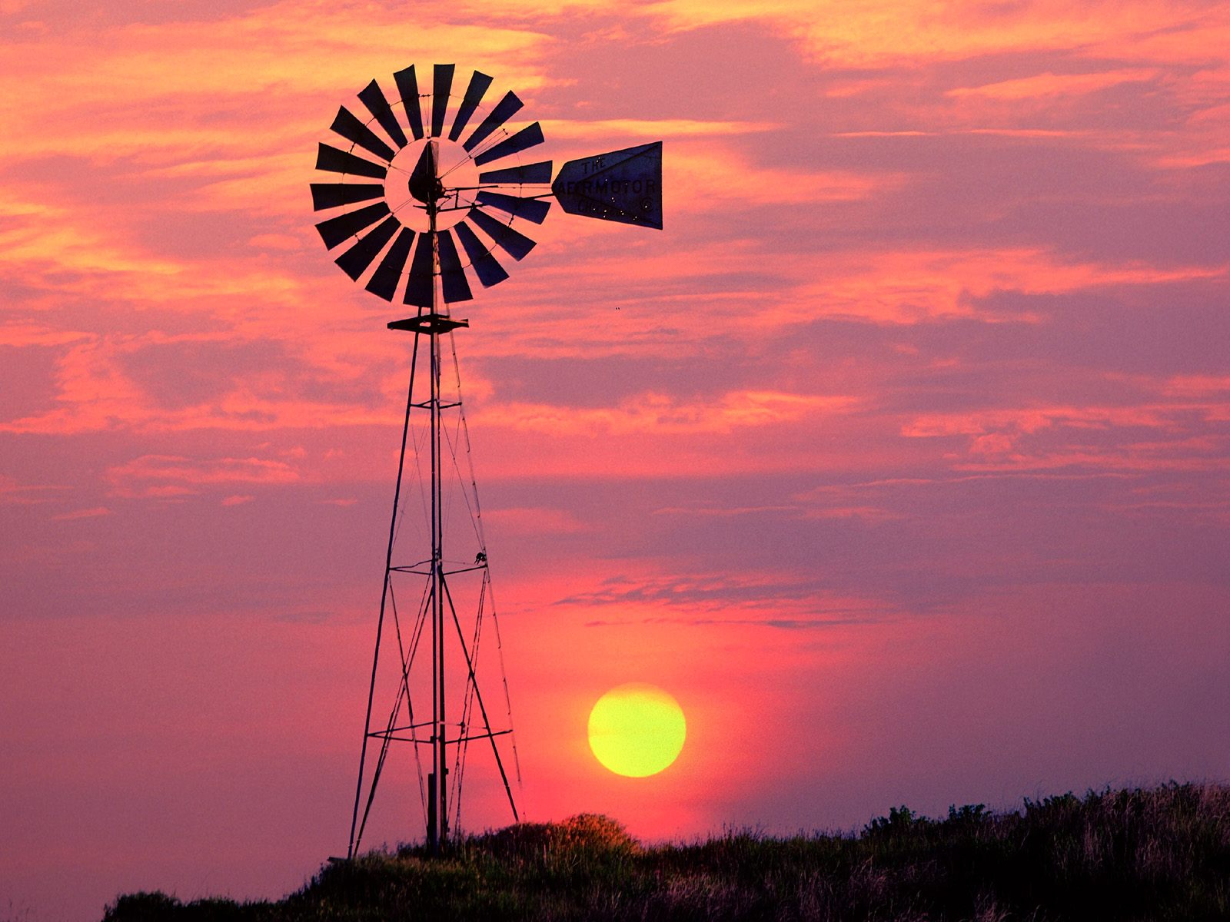
QUESTIONS?
Questions?

